Slide 1

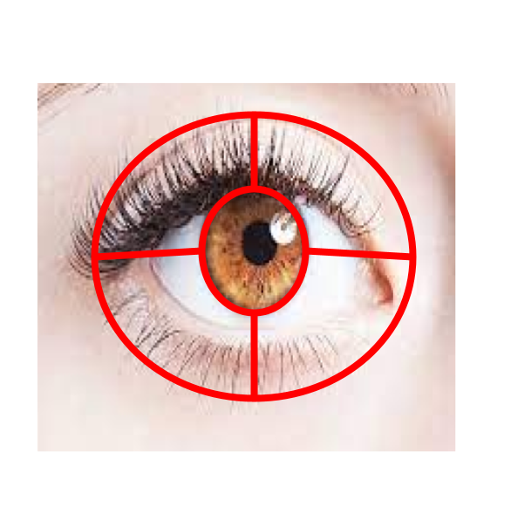
May I Have Your Attention, Please?
Marist-Ibm Datathon SPRING 2021
Josh Seligman, Meghan Urban, Michael Laffan

Slide 2
“Whether it is in a sales situation, love at first sight, a husband and wife having an important conversation, a parent disciplining a child, or a teacher instructing her students, eye contact is a powerful body language for enriching engagement, focus, and communication.”
- Susan C Young

Slide 3
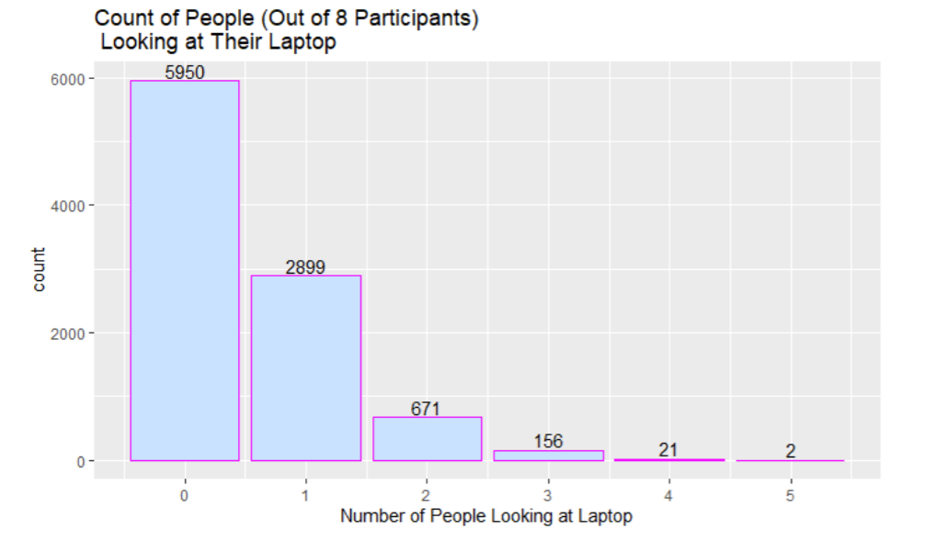
Number of People Paying Attention at an Instance of Time
In this case, an instance of time is equal to 1/3 of a second.
Data Source: http://snap.stanford.edu/data/comm-f2f-Resistance.html
Notes:
In 2019, researchers at Stanford investigated in the attention spans of individuals in a virtual environment. The data they collected involved checking to see whether or not an individual was looking at their laptop at a given time interval. They published their collected data and we decided to calculate the average attention span for each participant on the laptop screen and away from the laptop screen (the average of consecutive number of ones or zeroes divided by 3), and the longest span of focus on the screen and away from the screen, which is the amount of time it takes to regain focus. The calculations show that both the average attention spans and maximum attention spans on the laptop screen are significantly short, compared to the spans away from the laptop. To improve upon this, we developed an app

Slide 4
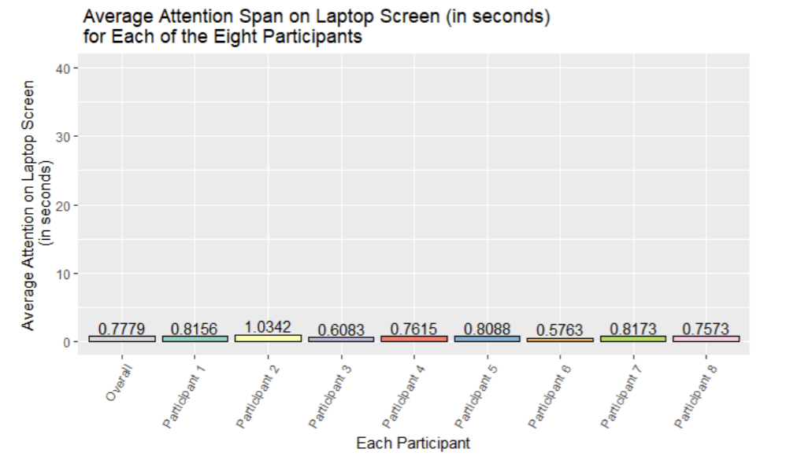
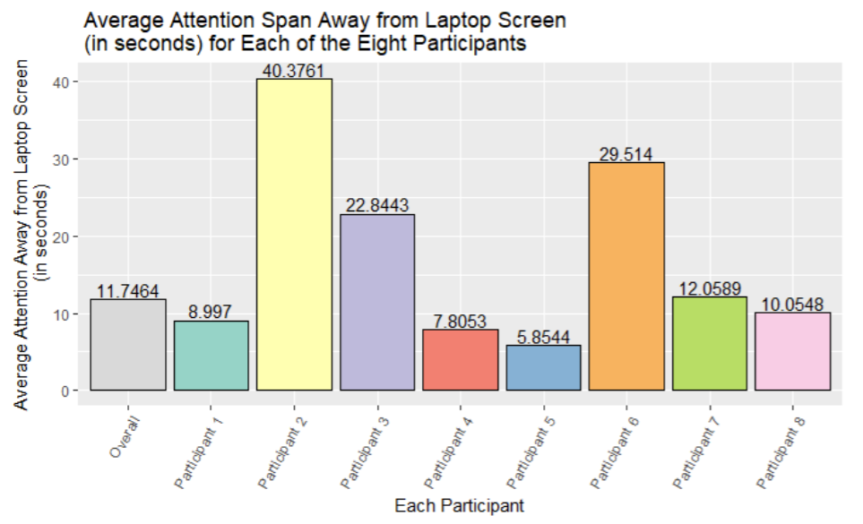
Average eyes
ON VS.
Away From
The Screen
Data Source: http://snap.stanford.edu/data/comm-f2f-Resistance.html

Slide 5
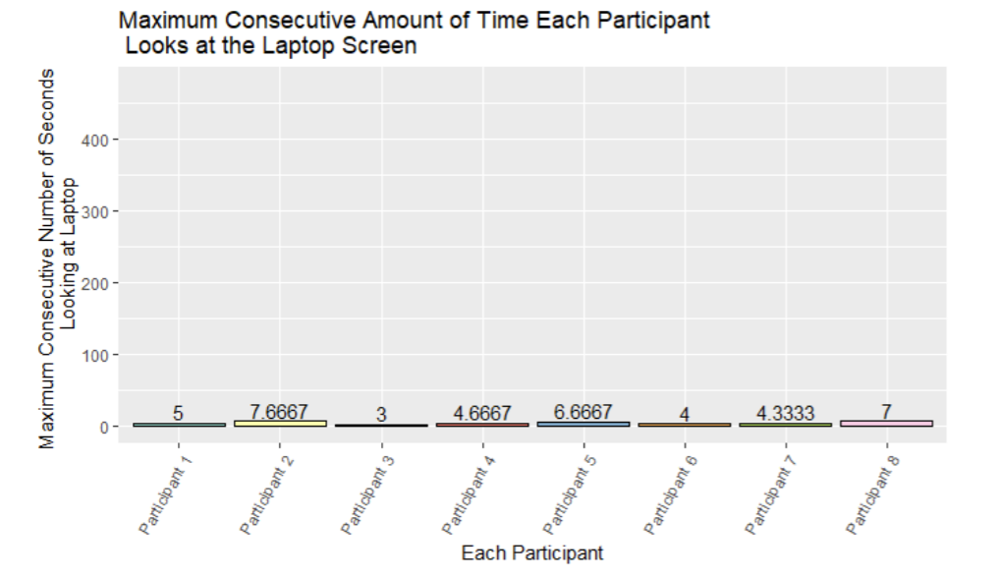
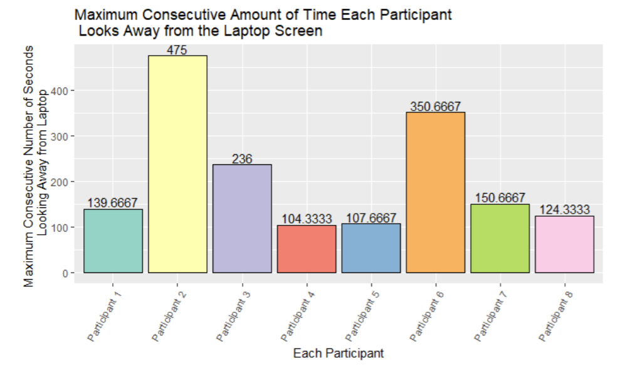
Time It Takes To Regain Focus
Focus
Duration
VS.
Data Source: http://snap.stanford.edu/data/comm-f2f-Resistance.html

Slide 6
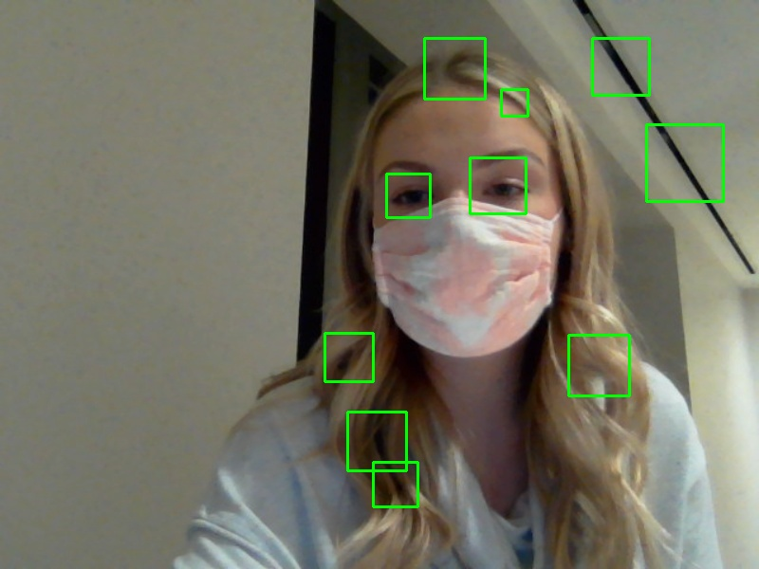
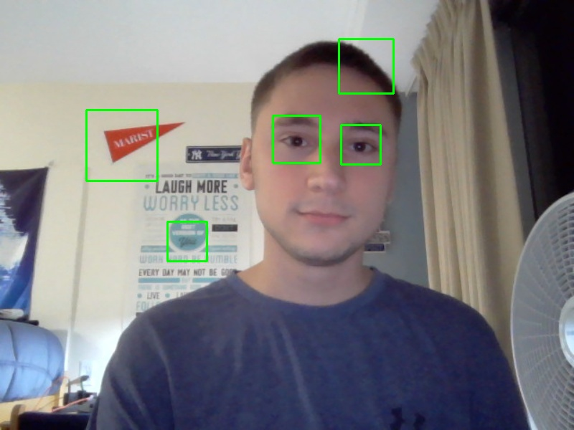
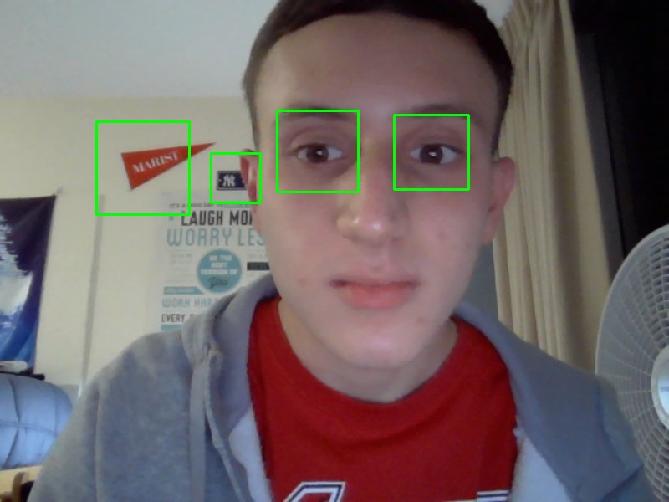
The Model and Application
Saved and analyzed over 1,000 pictures (500 positive and 500 negative)
Identified the location of the eyes in the positive images
Used OpenCV to train a Cascade Classifier to look for eyes in pictures with 95% accuracy
Used the results of the model to determine the location of the user’s eyes
Displayed the results in a Kivy application

Slide 7
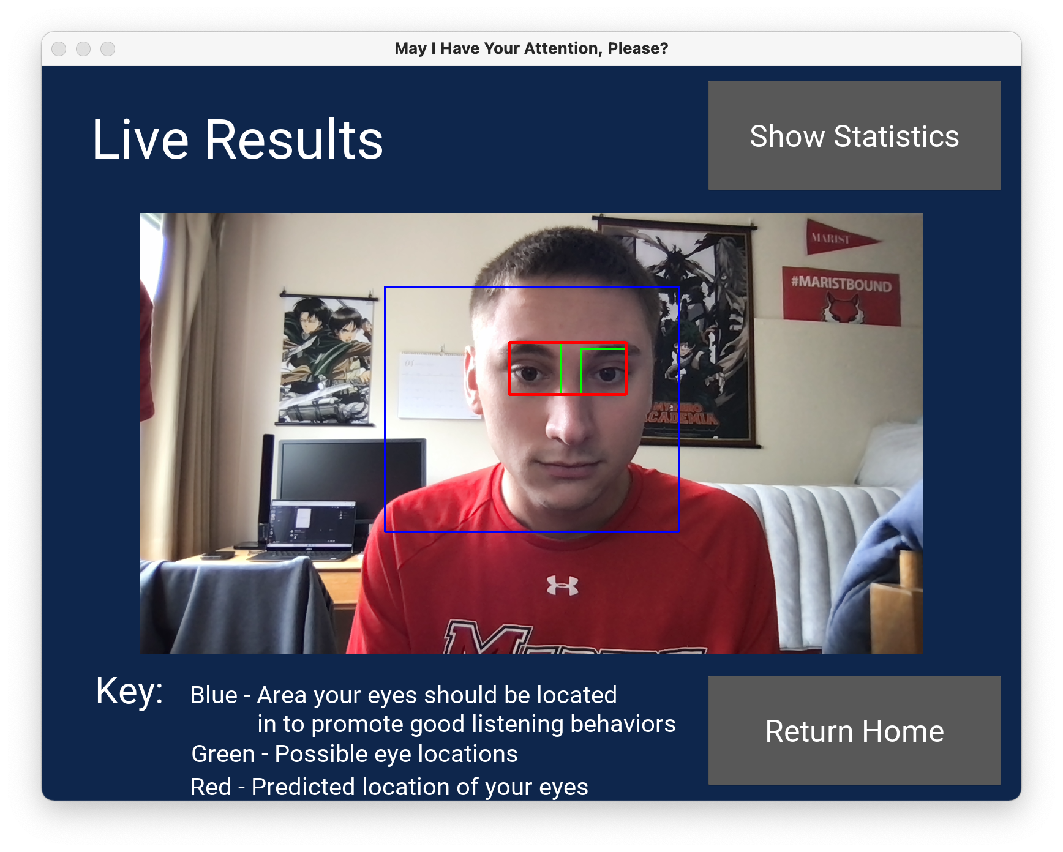
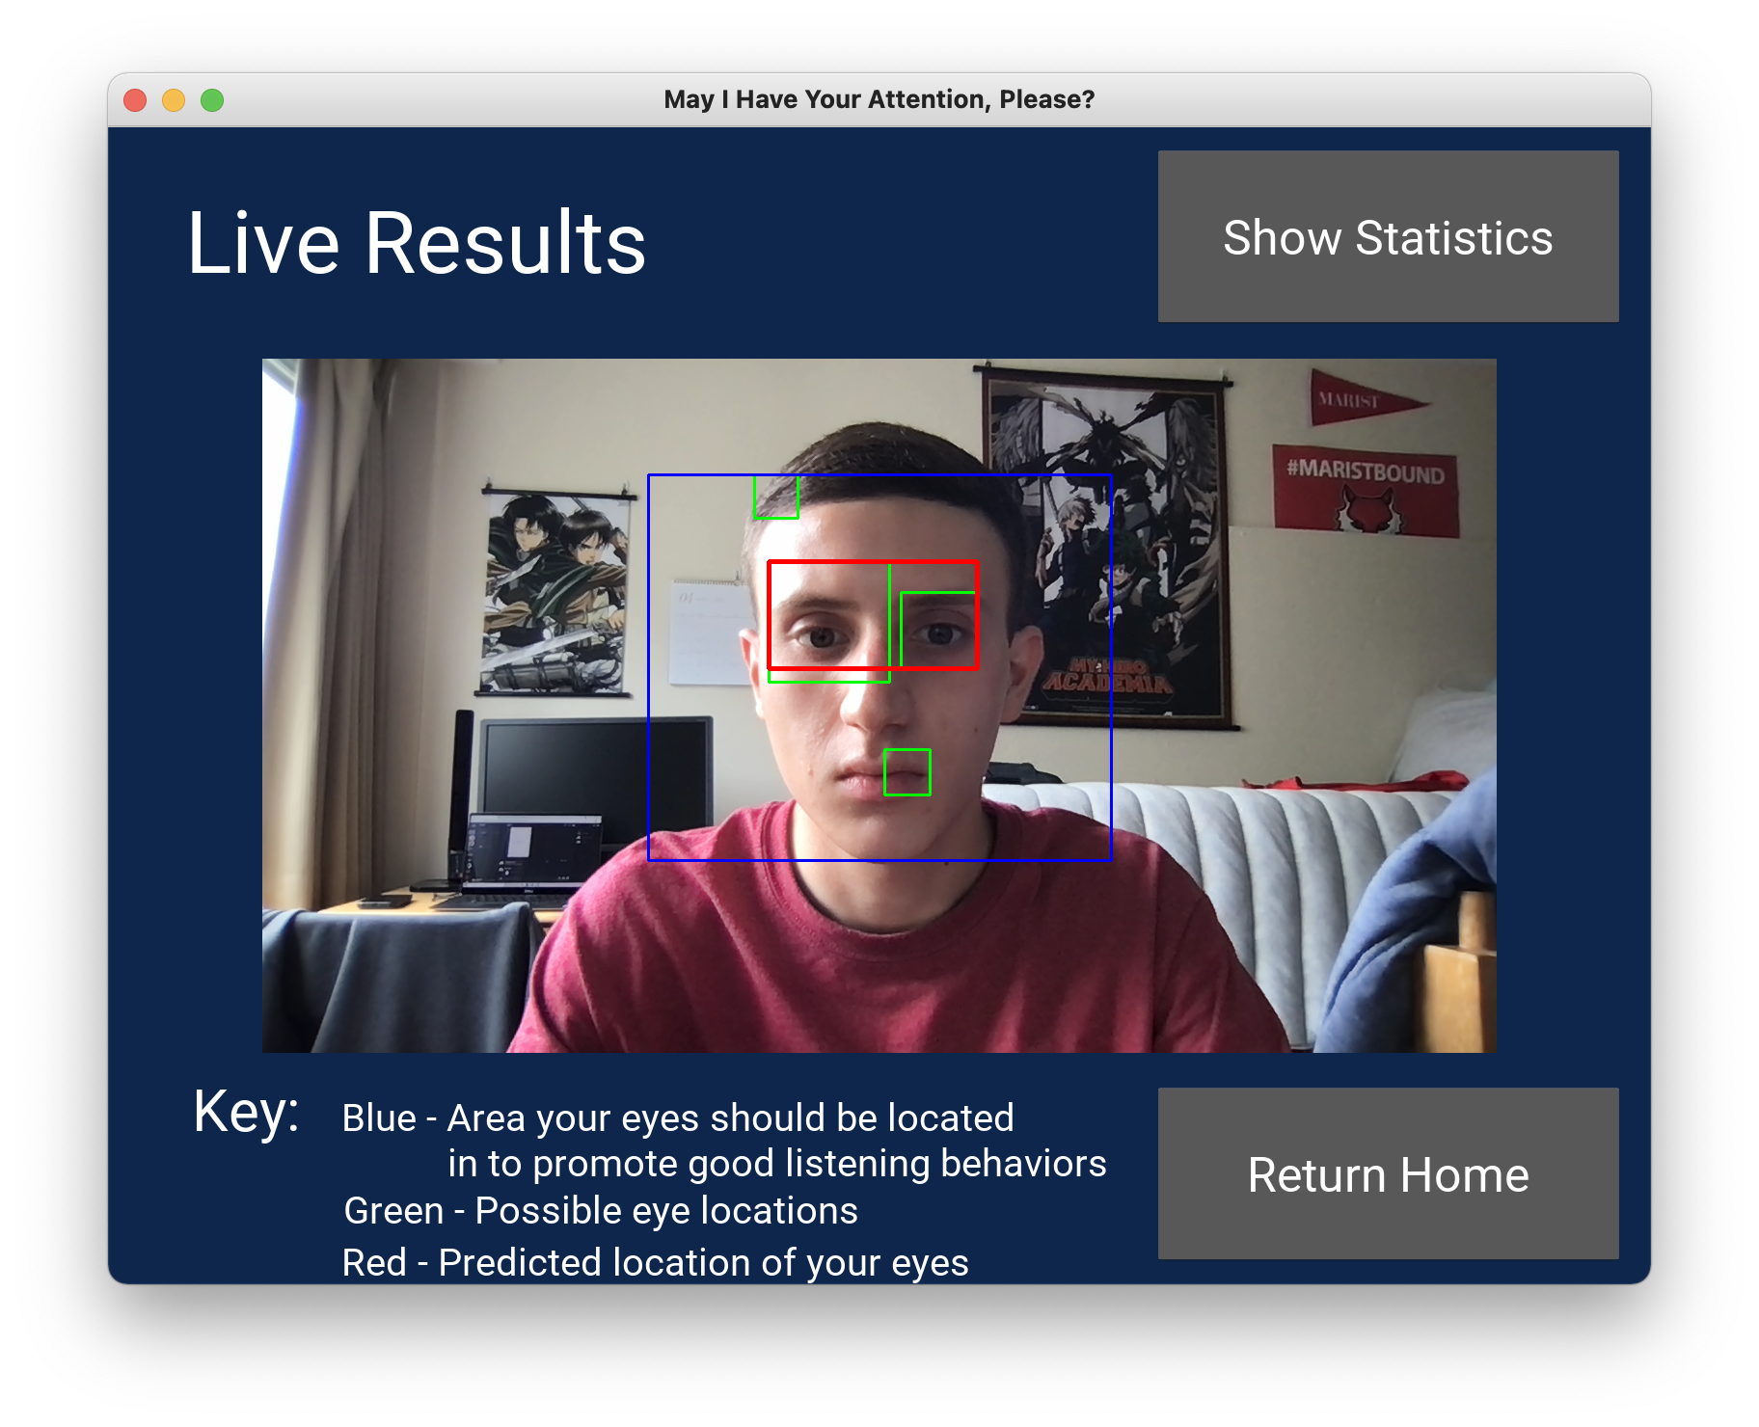
DEMO

